Slide 1

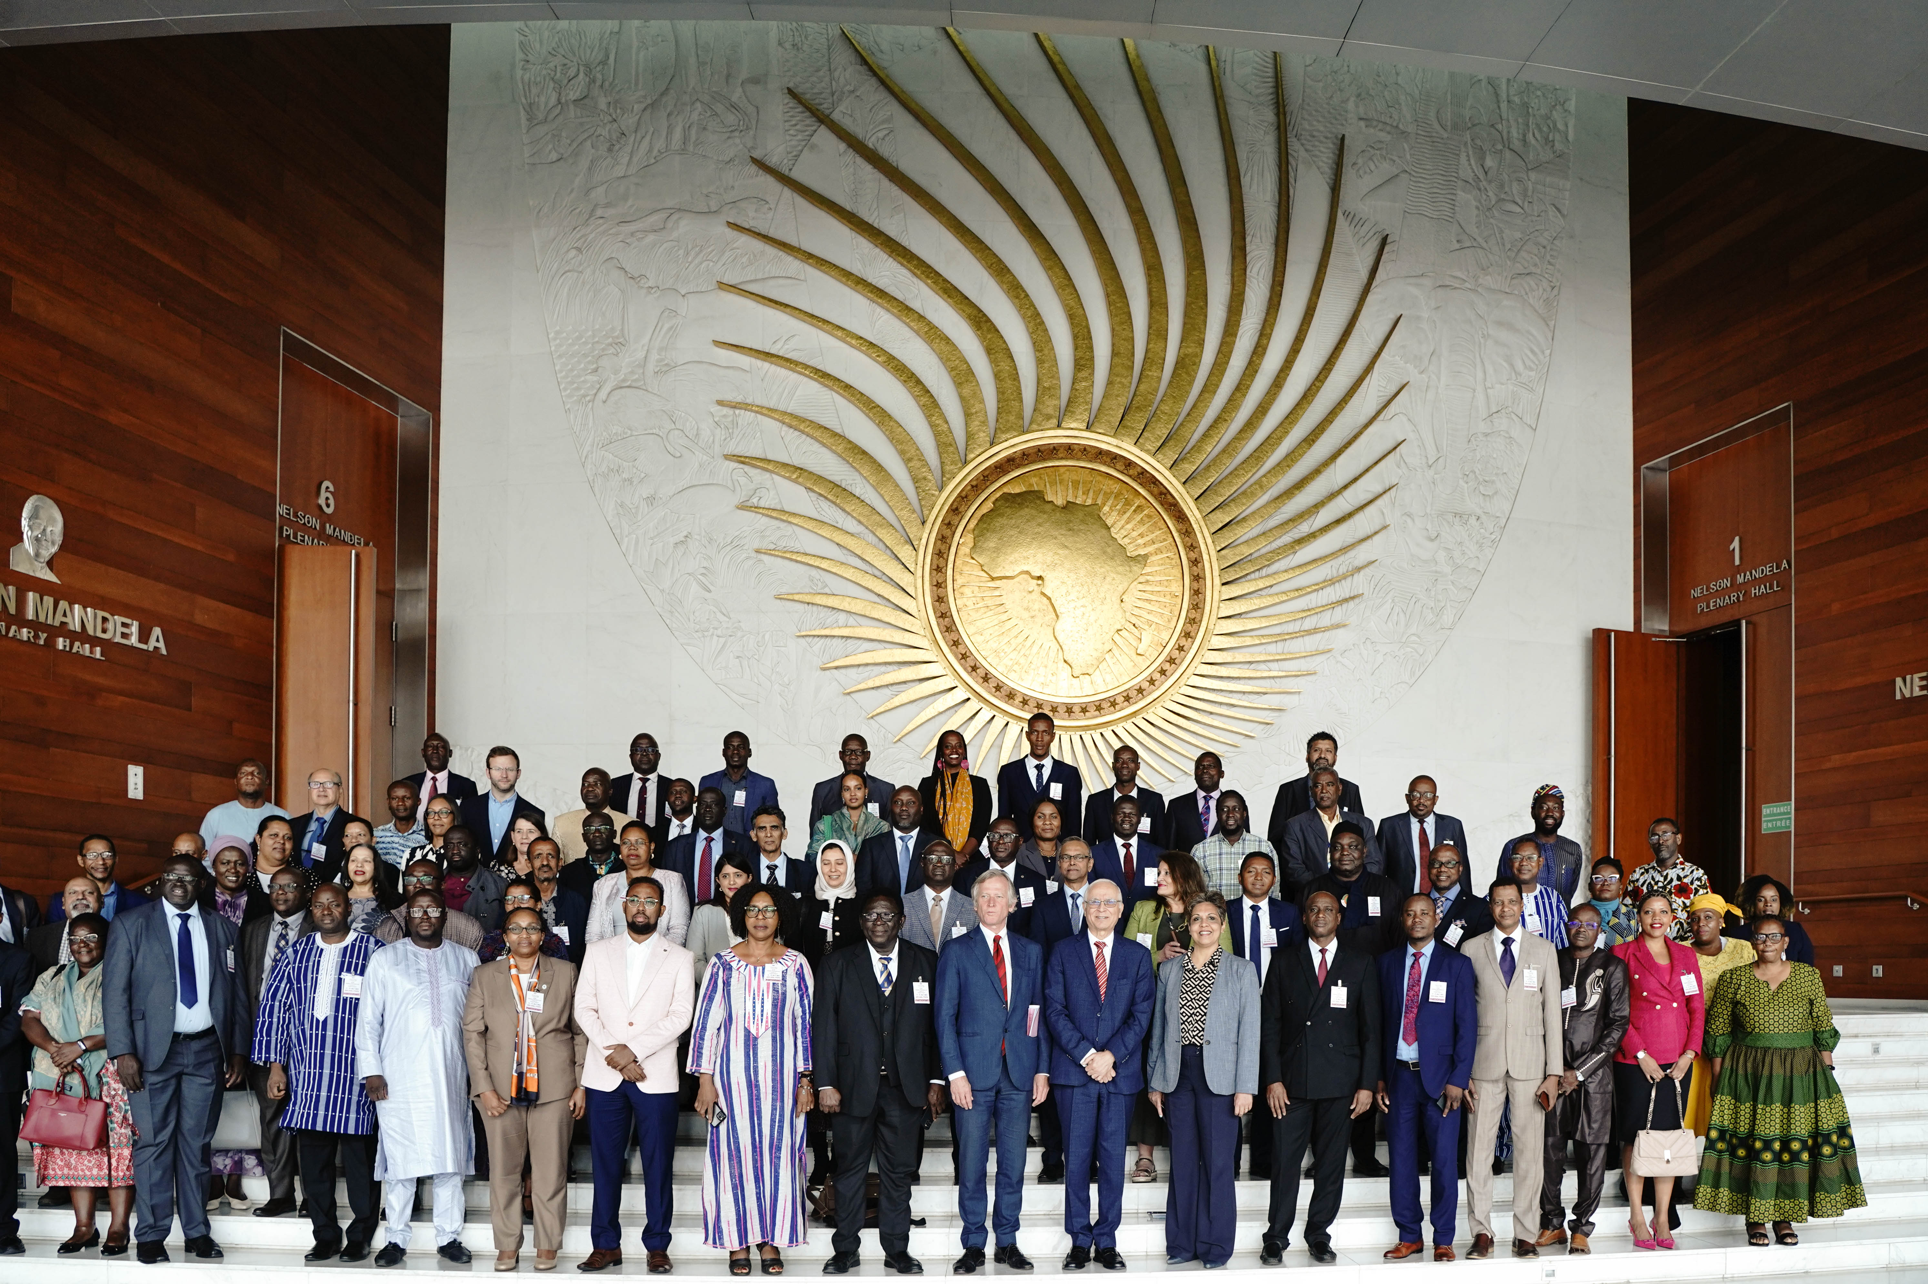
ACQF-II
2026 Project Progress
and Transition Planning
7th ACQF Continental Forum, Nairobi, 28 July 2026
Maria Rosenstock, European Training Foundation

Slide 2
Objectives:
Mercy Ngoma
Challenge:
improved transparency and comparability of qualifications
improved mutual trust and information-sharing between qualifications frameworks and systems on the continent
enhanced recognition of skills and credentials
Qualifications across countries and systems are very diverse
ACQF provides a common reference frame for qualifications levels.
Wider impact:
Improved mobility and lifelong learning opportunities

Slide 3

ACQF-II Project (2023 – 2026): Support to the implementation of the African Continental Qualifications Framework (ACQF II), financed by the European Union, implemented by ETF in cooperation with African Union Commission, the regional communities and member states
ACQF – Continental Tool, African Union Policy Initiative based on ACQF policy document validated by member states in July 2023, in Addis Ababa
ACQF Network – launched in January 2025 to support and sustain the implementation of the ACQF and its Qualifications and Credentials Platform

Slide 4
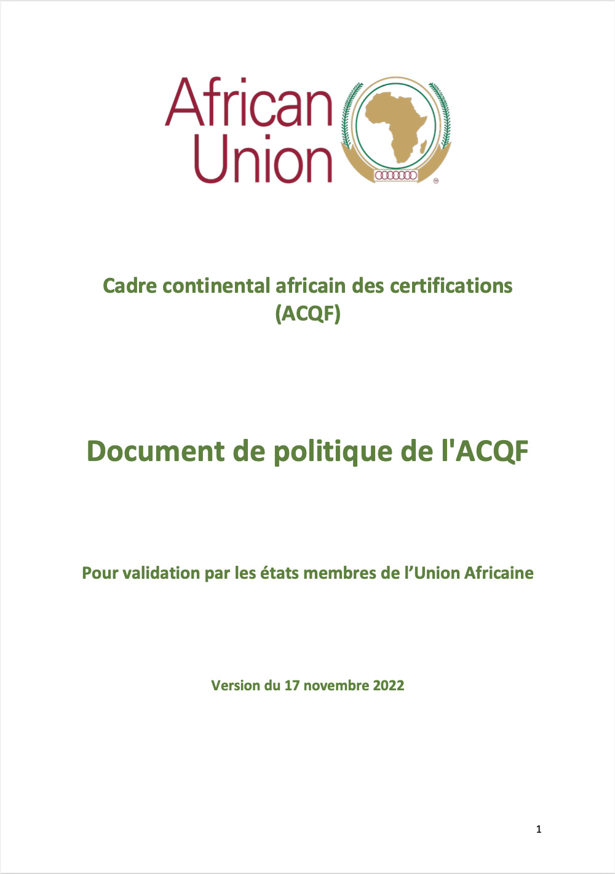
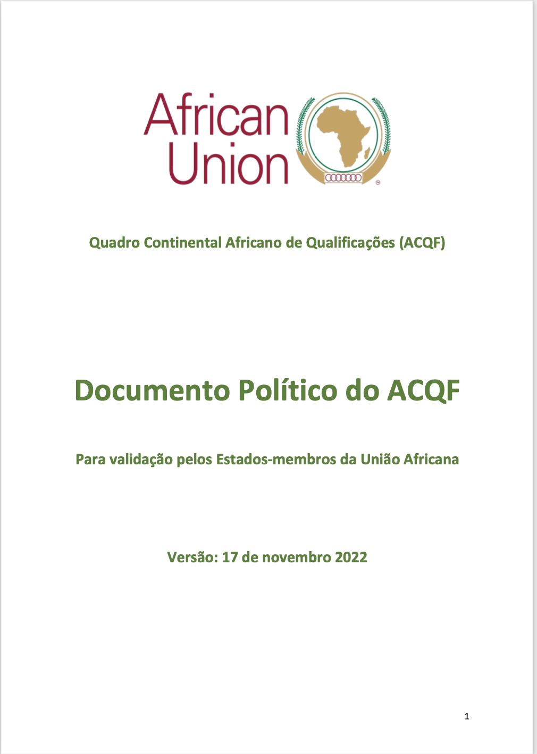
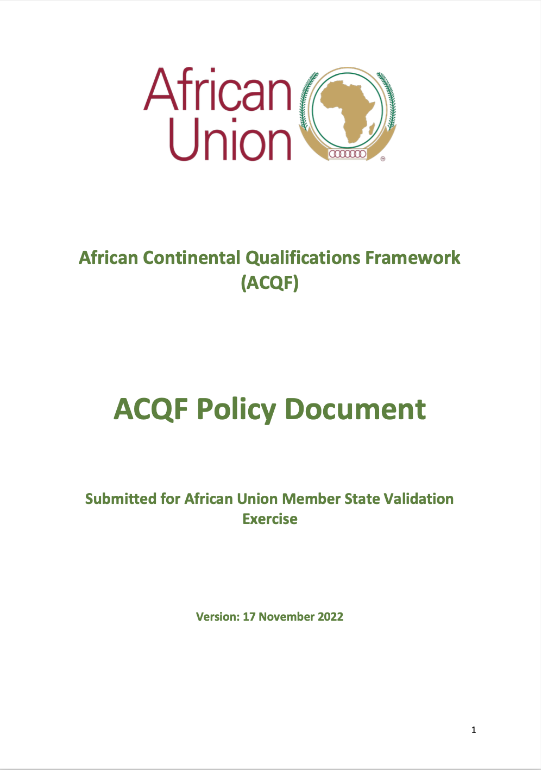
https://acqf.africa/resources/policy-guidelines/acqf-policy-document-upon-validation-by-au-member-states-en-fr-pt

Slide 5
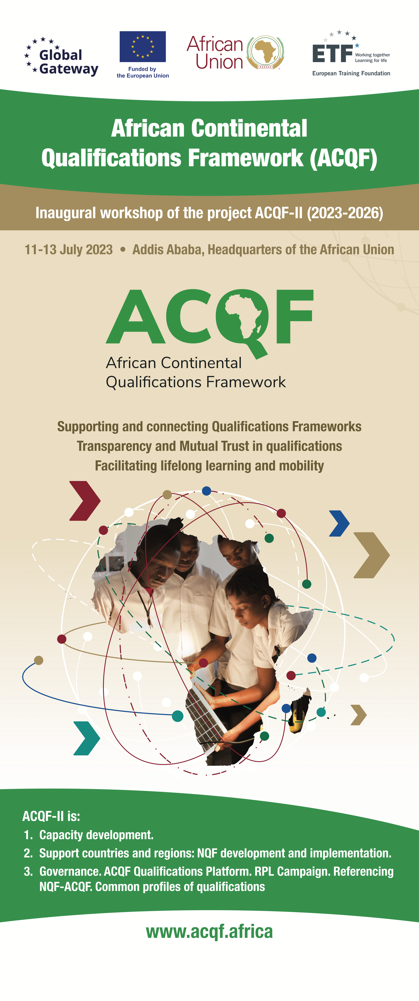
Main areas of activity of the ACQF
1.Referencing of national qualifications frameworks and systems to the ACQF, following agreed criteria and procedures.
2. Support recognition of prior learning – development of guidelines and approaches, inventory of RPL systems on the continent, information campaign
3. ACQF Qualifications and Credentials Platform (QCP) and management information system
4. Common occupational profiles: Development of qualifications profiles suitable for common continental use (e.g.: related with economic integration / AfCFTA).
5. Capacity development in NQFs, RPL, CATS. Online, onsite, hybrid.
6. Advocacy, communication, networking and cooperation: among African stakeholders and other RQFs globally
7. Analysis, monitoring and evaluation: for continuous improvement.

Slide 6
Referencing

Slide 7
Importance of referencing
Enhances transparency and comparability
Builds trust and credibility in national qualifications systems
Strengthens national systems by promoting reflection and quality assurance
Enhances visibility at continental level by indicating ACQF levels on certificates and in the Qualifications and Credentials Platform (QCP)
Supports recognition of qualifications across borders
Contributes to regional integration and economic cooperation
Notes:
Enhances transparency and comparability of qualifications across countries through a shared continental reference framework
Builds trust and credibility in national qualifications systems by demonstrating alignment with agreed ACQF principles and criteria
Strengthens national systems by promoting reflection, coherence and quality assurance within NQFs and qualifications frameworks
Enables visibility at continental level by allowing qualifications to be presented and compared via the ACQF Qualifications and Credentials Platform (QCP)
Supports recognition of qualifications across borders, facilitating mobility of learners and workers in Africa
Contributes to regional integration and economic cooperation, in particular skills mobility agendas

Slide 8
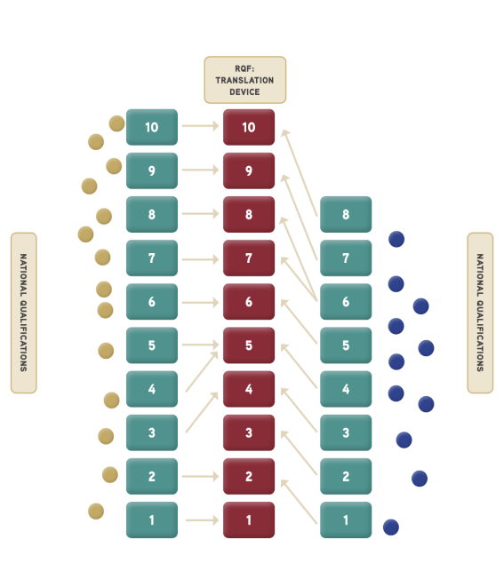
Referencing report
Systematically presents and documents the broader qualifications system and the NQF of the referencing country.
Establishes a clear and transparent relationship between national qualification levels and the ten ACQF levels (level-to-level correspondence) → Criterion 1
Demonstrates alignment with agreed ACQF principles → Criteria 2-4
Complies with governance procedures
Referencing criteria and procedures are specified in the ACQF Policy Document (Annex 2)

Slide 9
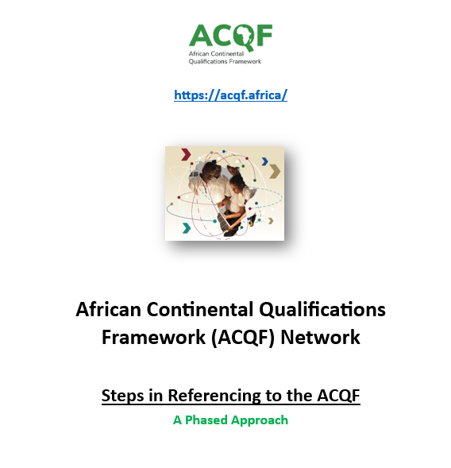
2026 - New tools developed
Procedure with roles of ACQF Network developed and discussed
Checklist for quality assurance of the referencing reports prepared
Materials available at: https://acqf.africa/resources/referencing/referencing-to-acqf
https://acqf.africa/resources/referencing/referencing-to-acqf

Slide 10

ACQF becomes operational!
Capacity building:
  webinar on Referencing for the ACQF Network,
  bilateral meetings with countries, bespoke capacity building workshops upon request (Botswana, Zimbabwe planned)
Support to national stakeholders’ workshops
Seychelles, Kenya and Cabo Verde – presentation of full referencing reports at the 7th Forum in Nairobi in July
South Africa, Zimbabwe, Lesotho - shared their draft reports
Botswana – drafting ongoing.

Slide 11
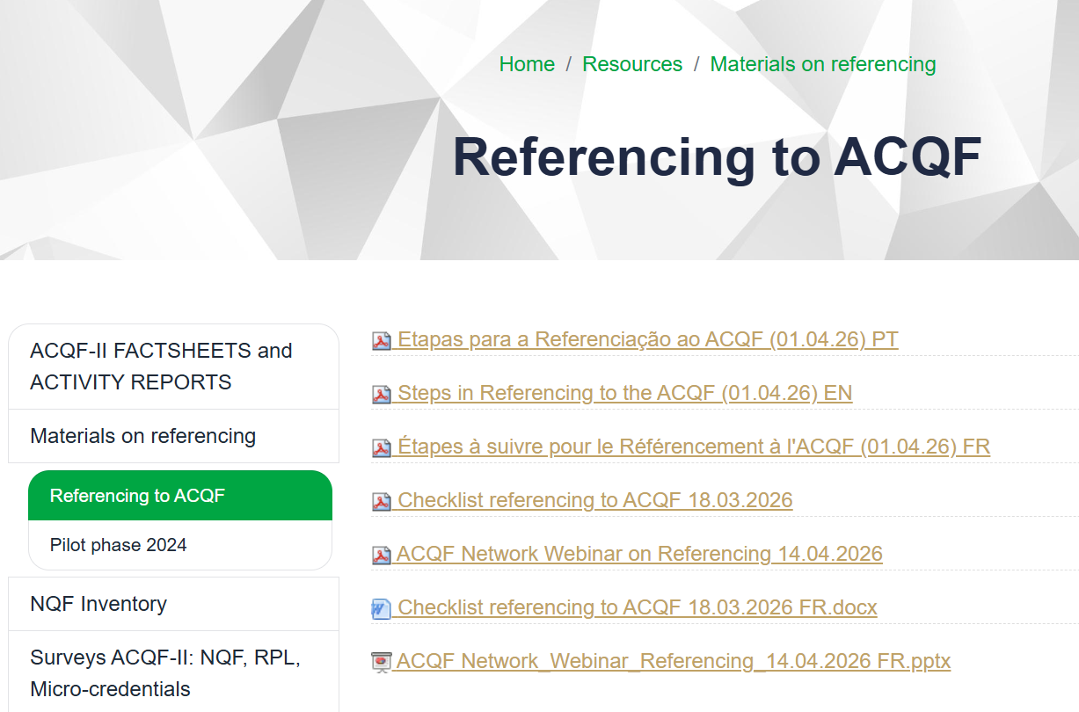

Slide 12
02
Support to RPL

Slide 13
2026 - Focus on pilot RPL schemes
Cameroon: mission in January, preparations for pilot scheduled in September
Tunisia: awaiting the approval of the Ministerial Decree
Botswana: ongoing preparations for a pilot, proposal to revise funding formula
Seychelles: RPL monitoring system, evaluation of system performance
Senegal: planning has started
Eswatini: advanced planning

Slide 14
03
Qualifications and Credentials Platform

Slide 15
QCP - Data Curators’ Interface
- open for manual and automatic data entry
Ongoing support on data entry, focus on quality of data and automatic publication
Public User Interface
Countries have started sharing their data in the QCP
Launched!
https://public.acqf-qcp.africa/
Capacity building
On-line course available
https://elearning.acqf-qcp.africa/
Individual Country support available upon request
Notes:
Future is about data!

Slide 16


Slide 17
04
“Development of qualifications profiles adequate for common continental use related to new and emerging occupations, technology skills, and occupations linked with continental integration policies such as AfCFTA; and to continental strategies in specific economic sectors […]”
Common Occupational Profiles

Slide 18
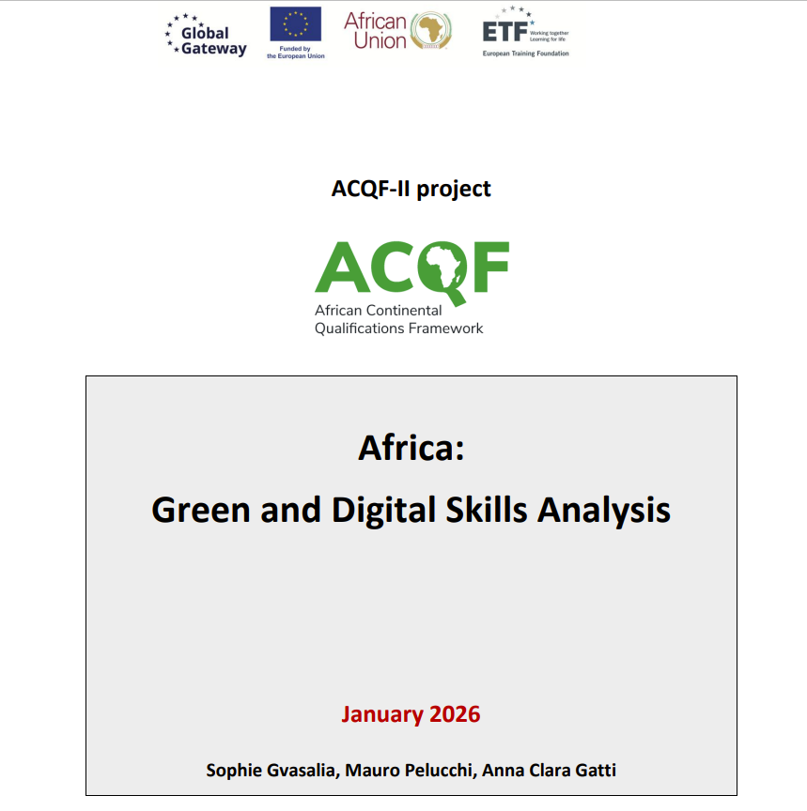
4. Common Skills Profiles:
    Kenya
    Morocco
    Tunisia
    Egypt
Skills Data Focus
Online Job Ads Analysis: real-time labour market intelligence - data on occupations, sectors of economic activity, skills, education, digital skills, green skills.
Green skills dashboard: a new data visualisation tool focused on green occupations and green skills
42 Occupational profiles currently visible with skills and trends
Analytical report on Green and Digital Skills - Green and Digital Skills in Africa: Insights from online labour market data — ACQF

Slide 19

Common Profiles – in partnership with ILO and qualifications agencies
NEW INITIATIVE
Coordinating bodies selected:
Namibia (NQA+NTA) for: green hydrogen, renewable energy
ZAQA for: mining, agriculture
KNQA for: agriculture
Next steps:
Agreeing on the standards to be compared
Constituting working groups, vetting experts
Contractual arrangements with coordinating agencies and kick off meetings
Development of common standards and assessment criteria.
Target: 3 working groups, 8-10 common standards
Work mostly on existing materials
ILO’s support:
Review of the methodology
Facilitation of partners from tripartite bodies: employers and workers
List of countries agreed with Cluster 3.

Slide 20
05
Capacity development – support to countries (NQFs, RPL, CATS)

Slide 21








2. Support to countries
Botswana:
Roll-out of 9 policies (RPL, referencing, assessment…)
Cameroon:
RPL pilot – preparation
Delivery in autumn 2026
Eswatini:
RPL pilot
Kenya:
Review of the
referencing report
Malawi:
Finalisation of NQF policy
Tunisia:
RPL pilot planned
Senegal:
RPL pilot
Finalisation of NQF policy
Sept 2024 Luanda: 2nd Forum NQF Authorities
Seychelles:
Micro-credentials policy and guidelines,
RPL monitoring
Rwanda:
RPL and stackability of credentials
Sierra Leone:
support to CATS policy
Zambia:
Micro-credentials policy

Slide 22



Collaboration with Regional Economic Communities
SADC –
  RPL Handbook and support to the annual
  SADC QF event
UEMOA
  series of 4 capacity building webinars on NQFs and RQF
EAC
  Development of Regional EAC TVET Qualifications Framework – in collaboration with ILO.

Slide 23
06
Advocacy, networking and cooperation

Slide 24
ACQF Governance – looking back
July 2023
December 2024
January 2025
ACQF Policy Document validated by AU Member States - governance principles agreed.
ACQF Network Inception Document prepared with countries; mission, objectives and lean structures agreed.
Network’s kick-off.
Members agreed that legitimacy required an elected Presidency.
ACQF Network Inception Document https://acqf.africa/acqf-network/acqf-sustainability-main-goal
Governance principles
Lean structures · Participation · Accountability · Rotational leadership · Strong country ownership

Slide 25

ACQF Network in 2025 – elections: legitimacy and ownership
Network’s Pilot Project in 2025
Organisation of the Network, governance
Identifying donor organisations, initiating contacts
ACQF implementation – continue referencing
Promotion and awareness building
Enhancing digital presence
Undertake common research
Support organisation of annual conferences
Campaigns
Network Presidency Elected – enabling leadership
South African Qualifications Authority – Nadia Starr
Kenya National Qualifications Authority – Dr. Alice Kande
Zambia Qualifications Authority – Mercy Ngoma

Slide 26

Mercy Ngoma
The Community – ACQF’s greatest strength
Members contribute because they believe in the value of continental cooperation.
The ACQF Network:
Active technical clusters
Exchange of expertise
Voluntary engagement
Trust between agencies
Mutual support

Slide 27
07
Analysis, monitoring and evaluation

Slide 28
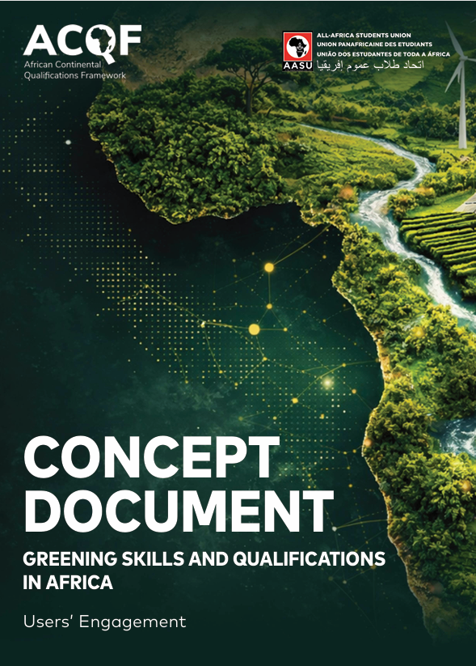


Collaboration with All African Students Union
Notes:
One of the exciting developments in the last year has been our collaboration with the All-Africa Students Union (AASU). The green transition is ultimately about the future of Africa's young people. They are the ones who will study for new occupations, enter changing labour markets, and drive innovation in green economies. Their perspectives therefore need to inform how qualifications evolve.
Working together with AASU allowed us to move beyond institutional discussions and engage directly with students and young professionals from across the continent. Through surveys, interviews and consultations with youth organisations, AASU collected evidence on how young people perceive green skills, what competencies they believe will be needed in the future, and where they see gaps in current education and training systems.
This collaboration resulted in three complementary products which will be presented :
First, the Concept Document, which presents the evidence gathered
proposes a user-centred framework for greening skills and qualifications.
Second, the Book of Good Practices, showcasing examples from across Africa that can inspire countries and institutions.
Third, the Toolkit, providing practical guidance to help policymakers, qualifications authorities, education providers and other stakeholders translate these ideas into implementation.
For ACQF, this partnership demonstrates another important aspect of the framework: co-creation. ACQF is not only a technical qualifications framework—it is also a continental platform that brings together governments, qualifications authorities, social partners, education providers and, increasingly, learners themselves.
I hope this collaboration with AASU will continue and serve as a model for ensuring that African youth remain active partners in shaping qualifications systems that are relevant, future-oriented and responsive to the continent's green transition.
.

Slide 29
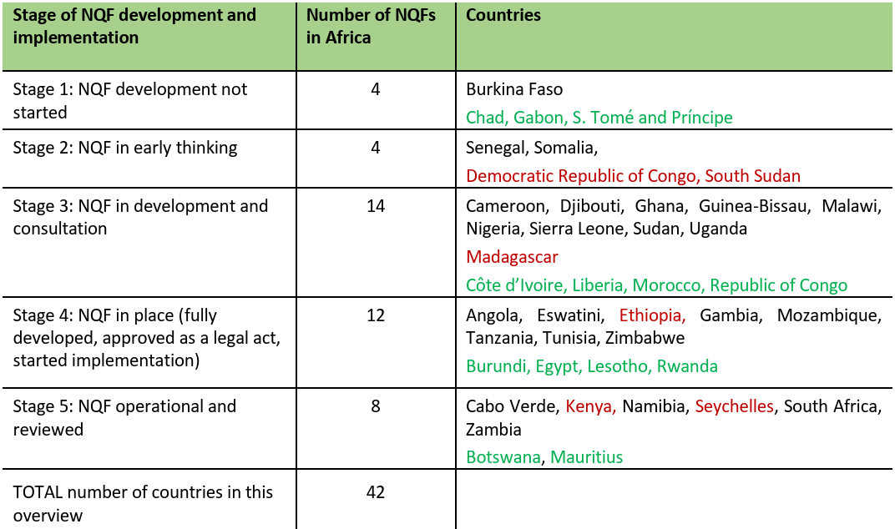
Launch of surveys:
NQF survey (2022, 2024, 2026)
Trends in evaluation and recognition of foreign credentials
Planned:
(3) Employers’ feedback on NQFs
https://acqf.africa/resources/surveys-acqf-ii-nqf-rpl-micro-credentials/survey-of-national-qualifications-frameworks-in-africa-analytical-report

Slide 30
08
ACQF-II Activities until completion

Slide 31
Priorities until end 2026
Completion of country support measures
Referencing - finalisation of all reports in the 2026 pipeline, webinar to present further reports
RPL pilots - up to 5 pilots
Supporting the Troika’s engagement in West Africa
ACQF at the Africa Skills Week
Feeding QCP with further data
ACQF Website - upgrade and revamping
Surveys - launching and analysis.

Slide 32
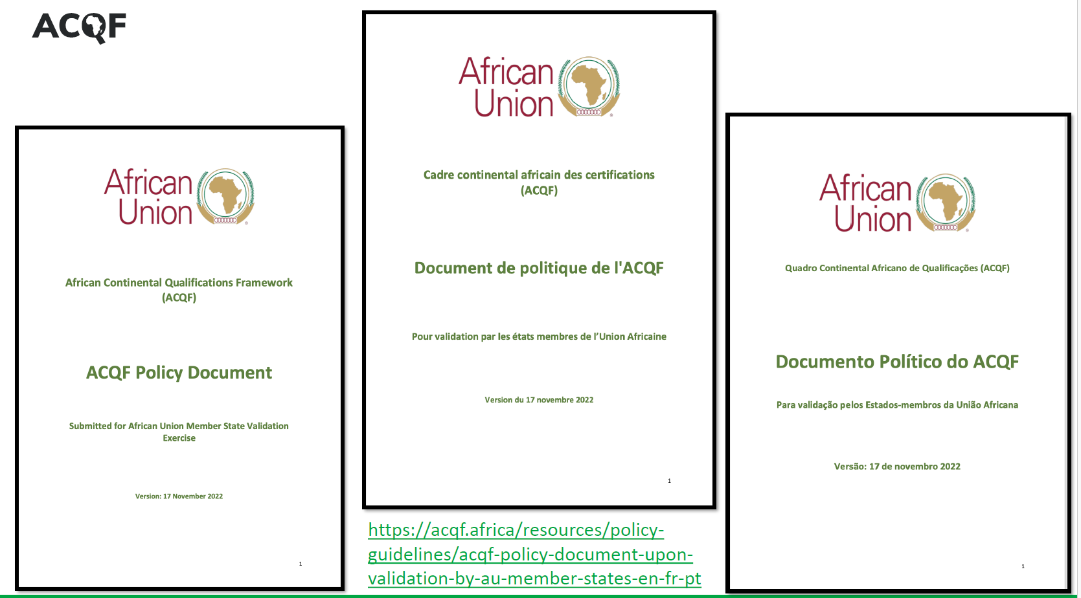
Formal adoption of the ACQF policy –
- November, AUC ministerial meeting
Advocacy
Resources

Slide 33
09
Transition Planning
Notes:
It is not only planning – transition is happening now. "Everything we've seen so far demonstrates what the project has achieved. The question now is: how do we ensure these achievements continue after the project ends?"

Slide 34
Transition towards sustainability: ETF’s role after 2026
Transition from ACQF-II project delivery to targeted, mandate-aligned cooperation with the Network.
1 | ETF operating model
2 | 2027 continuity support
3 | Support to advocacy
Annual core budget
Focused on EU Neighbouring regions and Central Asia under ETF’s mandate.
Extra-subsidy projects
European Commission project funding enabled ACQF implementation.
Growing interest in partnerships beyond our core mandate
Continue collaboration with the ACQF Network and share learning beyond the project.
Digital tools
QCP: ETF curates and keeps feeding the database;
ACQF website sustainability call / handover pathway.
Referencing
ETF can support the review of referencing reports and provide limited technical advice to the Network and countries.
North Africa & partners
Include more North African countries;
Connect EU Delegations,
Support advocacy with AfCFTA, AfDB and AUDA-NEPAD.
The ETF Qualifications Team is incorporating this support into 2027 operations but core-budget financial support outside the mandate will remain limited once QCP maintenance is covered.
Planning implication
Notes:
The key message is that ETF remains committed to cooperation with the ACQF Network, but the form of support shifts from project delivery towards targeted, mandate-aligned continuity support.
First, a word on how ETF operates. Our core budget is annual and mandate-based, not a project budget. It is primarily for ETF’s mandated partner countries in the EU Neighbouring regions and Central Asia. Wider ACQF support has been enabled through extra-subsidy projects with the European Commission and, where possible, other donors – this was the case of the ACQF-II project. This distinction is important for expectations after 2026.
Second, ETF’s role in Africa and globally is growing. ETF is increasingly acting as a global knowledge hub, and we have a strong interest in continued collaboration with the ACQF. North Africa is especially relevant, because it is part of ETF’s core partner-region mandate and offers natural synergies with ongoing ETF work.
In practical terms, we see targeted support continuing in 2027 in three areas. On digital tools, ETF can keep curating the Qualifications and Credentials Platform and support further feeding of the database; for the ACQF website, the sustainability call made before the Forum should help clarify the handover pathway. On referencing, ETF can continue to review referencing reports and provide technical advice. On advocacy, ETF can help loop in more countries in North Africa, create synergies with existing ETF activities, and support outreach to EU Delegations in Africa, AfCFTA, AfDB, AUDA-NEPAD and other relevant partners.
To summarise: ETF’s Qualifications Team is incorporating the implications of this continued support into our operational planning for the unit. This is good news for the Network and for us — we value the collaboration, believe in the effort, and see the commitment of this community and its leadership. At the same time, we have a clear resource boundary: support outside the core mandate has limits, and after covering the maintenance and further feeding of the QCP, there will be limited financial support available from ETF’s core budget.

Slide 35
Transition is already happening…
African Union Commission
Political steering
Strategic direction
The Troika - Setting direction
The Clusters - Implementation
- Network priorities
- Annual planning since 2025
- Representation of the Network
- Secretariat hosted by SAQA
- Technical work by countries
Members’ engagement and joint work
Peer learning and mutual support
The transition
Taking on activities previously coordinated by the project
ETF increasingly supports rather than leads
Notes:
We are not preparing the transition but implementing it.

Slide 36
ACQF activity areas and cluster responsibilities
Operational activities are assigned to technical clusters; Cluster 5 provides cross-cutting Presidency support.
1
Referencing
Cluster 1
ACQF Network’s
Presidency
2
Support to RPL
Cluster 3
3
QCP
Cluster 2
Cross-cutting role
4
Common profiles
Cluster 3
5
Capacity development and support to NQFs, CATS
Cluster 3
Leadership
Network’s registration
Advocacy
Fundraising
6
Communication and advocacy
Cluster 4
7
Analysis, monitoring and evaluation
Cluster 3
Planning to continue on Day 3 of the Forum…
Notes:
Information about transition which has started already: referencing – training to be carried out by cluster one members
Website – training for the members of cluster one to curate the content

Slide 37

Work still ahead
- Legal registration in Kenya and adapted governance and operational modalities
Identifying long-term hosts for the ACQF website – call shared prior to the Forum
ETF will host the QCP beyond 2026 - migration to ETF’s digital environment
Defining long-term financing including how to maintain multilingual participation to assure independent operation after ACQF-II ends
Sustainability means money
Continental and online meetings, including interpretation
Website, communications, advocacy (mission)
Qualifications and Credentials Platform – technical support
Technical assistance and activities (policy workshops)
Possible mechanisms to be discussed
… planning to continue on DAY 3 of the Forum.

Slide 38

Mercy Ngoma
Lessons ACQF can share with PAQAA
1. Start the transition early - before the project ends.
2. Build the community before the institution.
3. Make governance transparent to create trust.
4. Distribute leadership through technical working groups.
5. Discuss financing as early as governance.
6. Recognise complementary political, technical and project roles.
7. Transfer decisions, responsibilities, knowledge and resources gradually.
Sustainable governance is not a handover event; it is a managed transition of ownership.

